Slide 1


Variables

Slide 2
Lisa

Slide 3
Computer Science is…

Slide 4
Review

Slide 5
Review
Method
private void solaDon() {
turnLeft();
}
for(int i = 0; i < N; i++) {
// to repeat N times
}
Loop
while(condition) {
// repeat while condition holds
}
if(condition) {
// todo if true
} else {
// todo if false
}
If-else statement

Slide 6
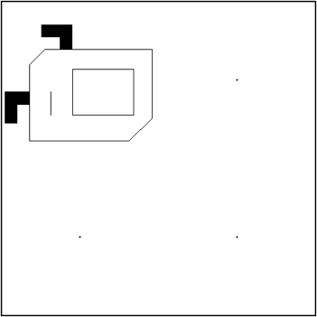
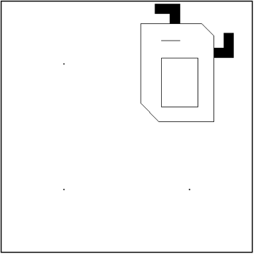
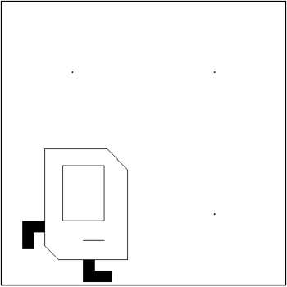
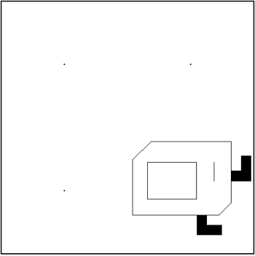
How Java works
public class HappyDance extends SuperKarel {
public void run() {
for(int i = 0; i < 3; i++) {
dance();
}
}
private void dance() {
for(int i = 0; i < 4; i++) {
git();
solaDon();
}
}
private void solaDon() {
turnLeft();
}
private void git() {
move();
}
}

Slide 7

How Java works
Java: I treat semicolons as something I need
to execute:
turnLeft();
Java: I treat curly braces as blocks of code.
for(int i = 0; i < 4; i++) {
git();
solaDon();
}

Slide 8
How Java works
Java: I treat method definitions as
blocks of code that might be run later.
private void solaDon() {
turnLeft();
}
Just a definition
Java: I only run methods when they are called as commands, using semicolons.
for(int i = 0; i < 4; i++) {
git();
solaDon();
}
The method git() is executed

Slide 9
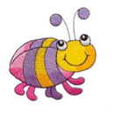
How Java works
Java: I hate it when you mix semicolons and
curly braces together.
private void solaDon(); {
turnLeft();
}
Java: I thought it was a method definition, but
why are you commanding me?

Slide 10
How Java works
Java: I hate it when you mix semicolons and
curly braces together.
for(int i = 0; i < 4; i++); {
git();
solaDon();
}
Java: Literally the worst
Java: Please don’t do this

Slide 11
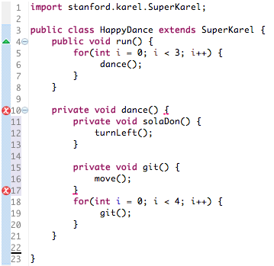
How Java works
Java:
Bruh/Gurl…
I can’t understand nested method definitions.

Slide 12
Loops
Do something many times
public void void run () {
for(int i = 0; i < 10; i++) {
putBeeper();
}
while(beepersPresent()) {
pickBeeper();
}
// at this point
// definitely no beepers
move();
}
10x
beepersPresent()
Notes:
Ask them what they think the difference is between the two types of loops

Slide 13
Loops
Do something many times
public void void run () {
for(int i = 0; i < 10; i++) {
putBeeper();
}
while(beepersPresent()) {
pickBeeper();
}
pickBeeper();
move();
}
Error
Notes:
Ask them what they think the difference is between the two types of loops

Slide 14
If-else statements
if(frontIsClear()) {
move();
}
putBeeper();
// true
move();
// false
putBeeper();
if(frontIsClear()) {
move();
} else {
turnLeft(); {
}
putBeeper();
// true
// false
move();
turnLeft();
putBeeper();
Notes:
Ask them what they think the difference is between the two types of loops

Slide 15


Style

Slide 16
Decomposition
¿
Good
Or
Bad
?
Notes:
Sey → ”shay”

Slide 17
Decomposition
Good
Bad
public void run() {
putLineOfBeepers();
pickEndBeepers();
pickAllBeepers();
putMidpointBeeper();
}
public void putLineOfBeepers() {
...
}
public void putLineOfBeepers() {
...
}
...
public void run() {
putBeeper();
while (frontIsClear()) {
move();
putBeeper();
}
turnAround();
pickBeeper();
while (frontIsClear()) {
move();
}
if (beepersPresent()) {
pickBeeper();
}
turnAround();
if (frontIsClear()) {
move();
}
if (frontIsClear()) {
while (beepersPresent()) {
while (beepersPresent()) {
move();
}
...
}
}
}
}
Use methods to decompose your code.
Notes:
Sey → ”shay”

Slide 18
Good or Bad?
Good
Bad
// moves karel one step
private void git() {
move();
}
// rotates karel
private void solaDon() {
turnLeft();
}
private void sey1() {
move();
}
private void sey2() {
turnLeft();
}
private void sey3() {
// pickBeeper();
putBeeper();
}
Use meaningful names for your methods.
Notes:
Sey → ”shay”

Slide 19
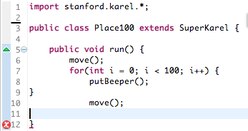
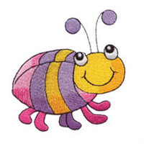
Match your curly braces

Slide 20
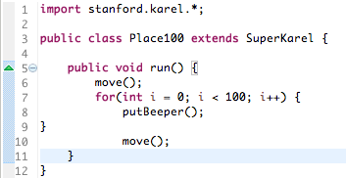
Coding Style
??
??
??

Slide 21
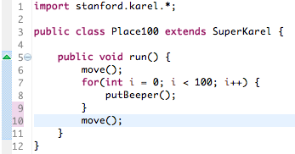
Coding Style

Slide 22
Humans Read Code, Too
Decompose by writing meaningful methods
Indent and match your curly braces

Slide 23
Programming takes practice.

Slide 24
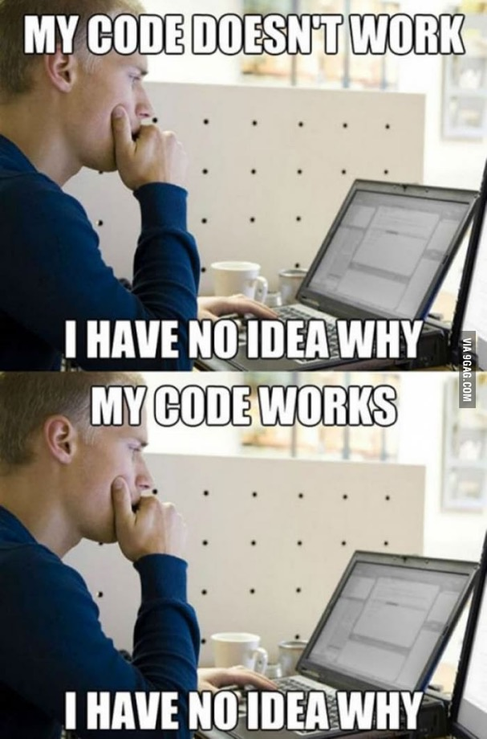
Classic CS

Slide 25
Use good coding style so that humans* can read your program.
*especially yourself and your section leaders

Slide 26
See You Later!
I will miss you.
Enjoy Java!
Call me maybe?
Notes:
He looks like an old machintosh machine.
Hes got legs… one sticks out the back. That’s just the way it is.

Slide 27

Java

Slide 28
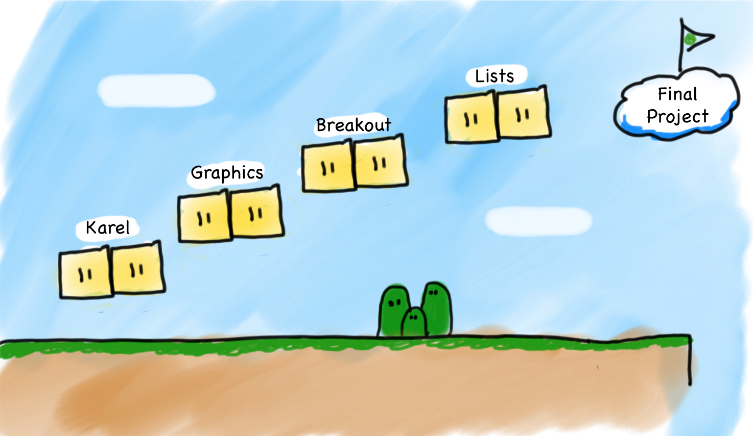
Very High Level

Slide 29
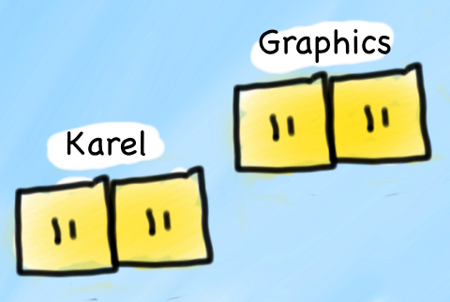
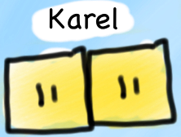
Slightly Less High Level
Consoles

Slide 30


Today’s Goals
How do I write a console program?
What are variables and how do I use them?
How do I get user input in a console program?

Slide 31
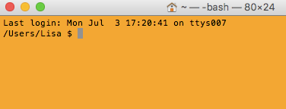
Console Program
Takes text input
Prints text output

Slide 32

First Console Program: Hello World
import acm.program.*;
public class HelloProgram extends ConsoleProgram {
public void run() {
println("hello, world");
}
}
HelloConsole
hello, world

Slide 33


In Pop Culture

Slide 34
Today’s Goals
✓
How do I write a console program?
What are variables and how do I use them?
How do I get user input in a console program?

Slide 35
Add2Integers
public class Add2Integers extends ConsoleProgram {
public void run() {
println("This program adds two numbers.");
int n1 = readInt("Enter n1: ");
int n2 = readInt("Enter n2: ");
int total = n1 + n2;
println("The total is " + total + ".");
}
}
n1
n1
n2
n2
total
total
17
17
25
25
42
42
Add2Integers
This program adds two numbers.
Enter n1:
17
Enter n2:
25
The total is 42.

Slide 36
What is a variable?

Slide 37
[suspense]

Slide 38
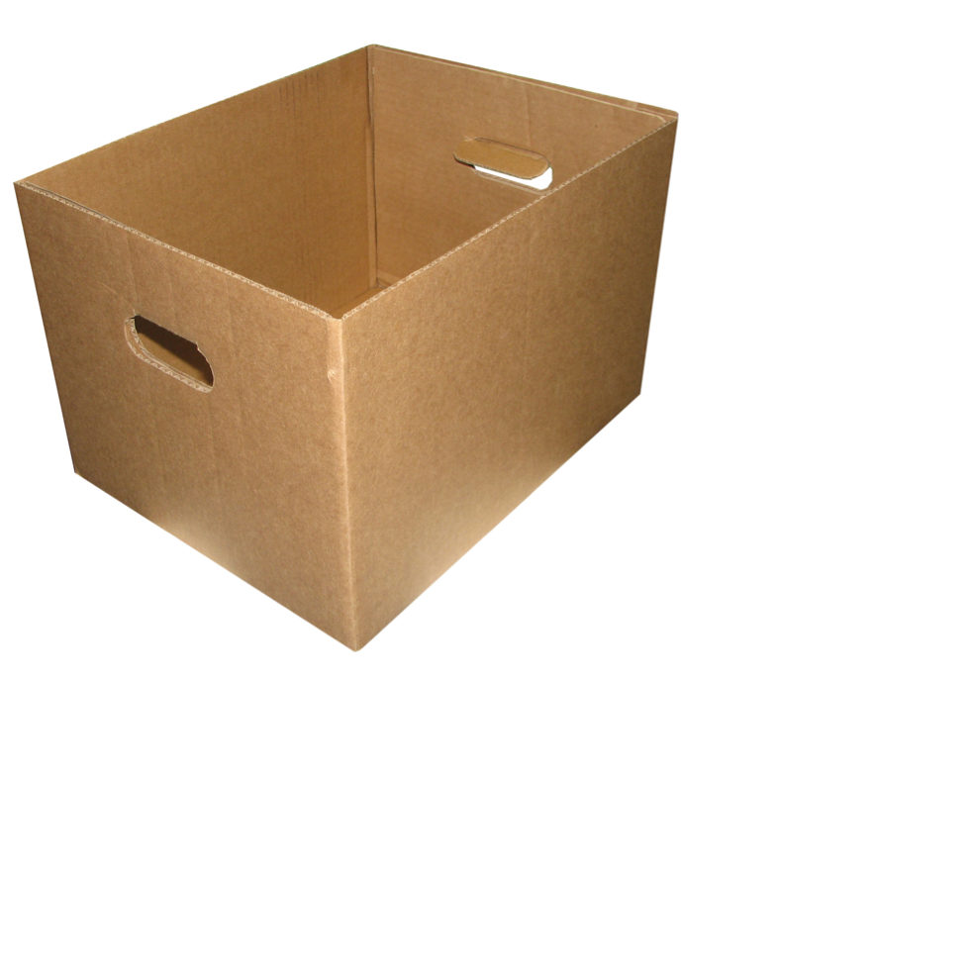
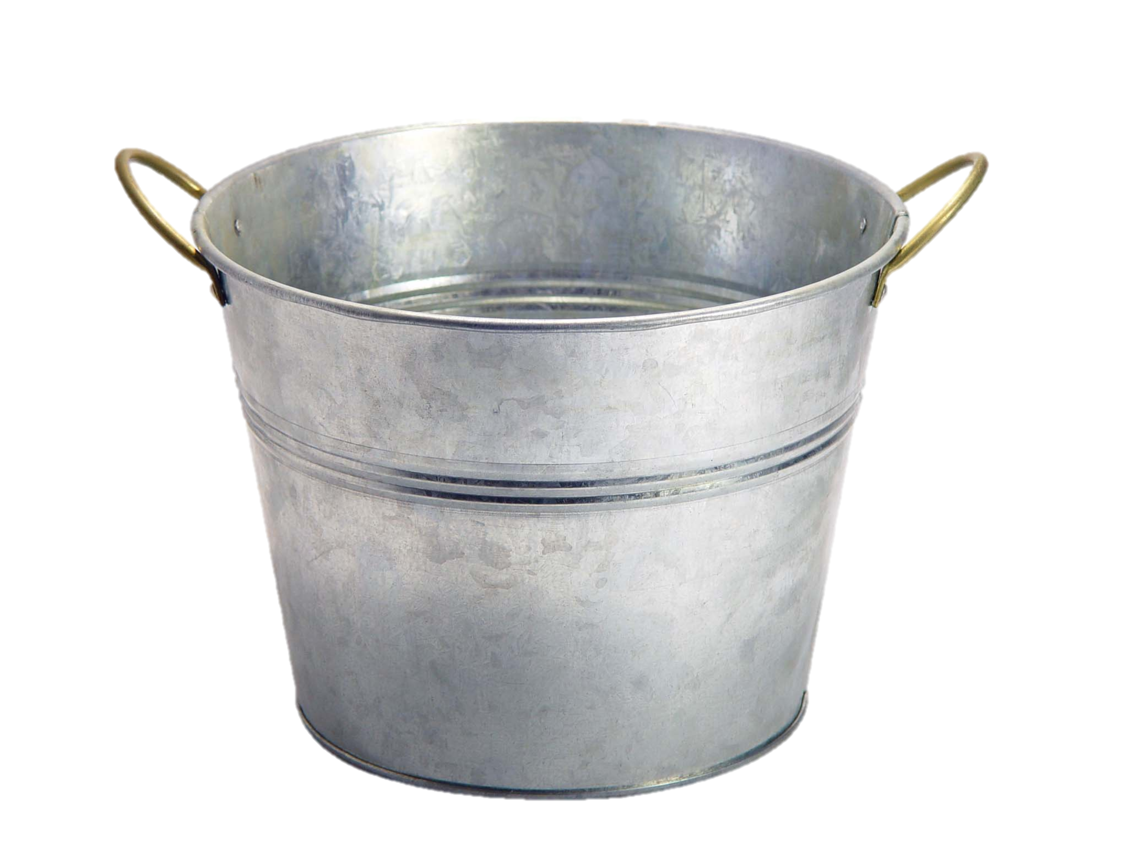
Variables are Like Boxes

Slide 39
Teeny Tiny Boxes
My computer has space for about 64 billion boxes

Slide 40
Three Properties
name
type
total
42
(contains an int)
value
Notes:
Type name = value

Slide 41
Types
// integer values
int num = 5;
// real values
double fraction = 0.2;
// letters
char letter = ‘c’;
// true or false
boolean isLove = true;
* Why is it called a double?

Slide 42
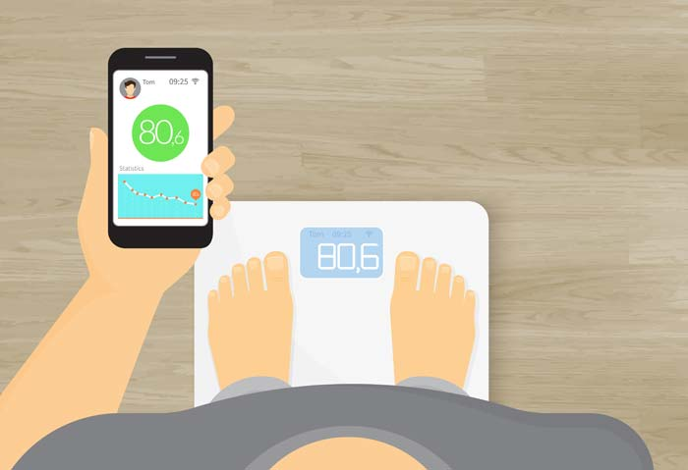
Double: How Much Do I Weigh?
* Answers could be real valued numbers

Slide 43
Int: How Many Children Do I Have?
* It is weird to say something like 1.7

Slide 44
Binary Operators
+
Addition
*
Multiplication
–
Subtraction
/
Division
%
Remainder
See you another day, tio.

Slide 45
Binary Operators
double width = 2.5; // meters
double height = 3.0;
double area = width * height;
name
width
height
area
value
2.5
3.0
7.5
type
double
double
double

Slide 46
Today’s Goals
✓
How do I write a console program?
What are variables and how do I use them?
How do I get user input in a console program?

Slide 47
User Input
int a = readInt(“msg”);
double b = readDouble(“msg”);

Slide 48
Add2Integers
public class Add2Integers extends ConsoleProgram {
public void run() {
println("This program adds two numbers.");
int n1 = readInt("Enter n1: ");
int n2 = readInt("Enter n2: ");
int total = n1 + n2;
println("The total is " + total + ".");
}
}
n1
n1
n2
n2
total
total
17
17
25
25
42
42
Add2Integers
This program adds two numbers.
Enter n1:
17
Enter n2:
25
The total is 42.

Slide 49
Birthday
public class Birthday extends ConsoleProgram {
public void run() {
println("This program celebrates birthdays.");
int age = readInt("Enter your age: ");
age = age + 1;
println("Happy birthday!");
println("You are now " + age + ".");
}
}
age
25
26
Add2Integers
This program celebrates birthdays.
Enter your age:
25
Happy birthday!
You are now 26.

Slide 50
Birthday
int age = readInt("Enter your age: ");
age = age + 1;

Slide 51
Definition: to assign (v.) –
to put a value into a variable

Slide 52
Birthday
int age = readInt("Enter your age: ");
age = age + 1;
value
name
value
age
type
(contains an int)

Slide 53
What do you think this does?
println(1 / 2);

Slide 54
AHHHHHHH!!!!!!
println(1 / 2);

Slide 55
Resulting Type
int + int results in an int
double + double results in a double
int + double results in a double
* The general rule is: operations always return the most expressive type

Slide 56
Pitfalls of Integer Division
Convert 100˚ Celsius temperature to its Fahrenheit equivalent:
double c = 100;
double f = 9 / 5 * c + 32;
The computation consists of evaluating the following expression:
9 / 5 * c + 32
The problem arises from the fact that both 9 and 5 are of type int, which means that the result is also an int.
132
100
1
9 / 5 * c + 32

Slide 57
Pitfalls of Integer Division
You can fix this problem by converting the fraction to a double, either by inserting decimal points or by using a type cast:
double c = 100;
double f = 9.0 / 5 * c + 32;
The computation now looks like this:
212.0
180.0
1.8
9.0
/ 5 * c + 32

Slide 58
Conditions

Slide 59
Conditions
<
Less Than
==
Equal To
>
Greater Than
>=
More or Equal
<=
Less or Equal

Slide 60
Favorite Number 5
public class FaveNumFive extends ConsoleProgram {
public void run() {
println("My favorite number is 5.");
int n = readInt("Guess my favorite number: ");
if (n != 5) {
println("Dude I just said it was 5.");
}
println("Time’s up!");
}
n

Slide 61
Conditions
if(x == y) {
...
}
Condition
x = y;
Assignment

Slide 62
Today’s Goals
✓
How do I write a console program?
What are variables and how do I use them?
How do I get user input in a console program?
✓
✓

Slide 63
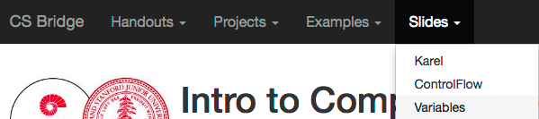
Website

Slide 64

Sandcastles
Hello World
Moon Weight
Random Numbers

Slide 65
More Fun
Favorite Number
Medicine Counterfeiting
Some Sum

Slide 66
The Most Fun
Game of Nimm

Slide 67
The End.

Slide 68

The End?

